Slide 1
RECYCLING AT COASTAL VILLAGE APARTMENTS
COLLOQUIUM SPRING 2011 FINAL PROJECT
MELISSA LOSEY

Slide 2
STEP ONE: INVESTIGATE
Where the recycling bins were supposedly located…

Slide 3
Still investigating…
Still no bins…

Slide 4
Investigating some more…
No bins here either!

Slide 5
Step 2: Ask the management
I attempted to ask the complex management where we could recycle, since having recycling available is the law. I was told there was none available at our complex.

Slide 6
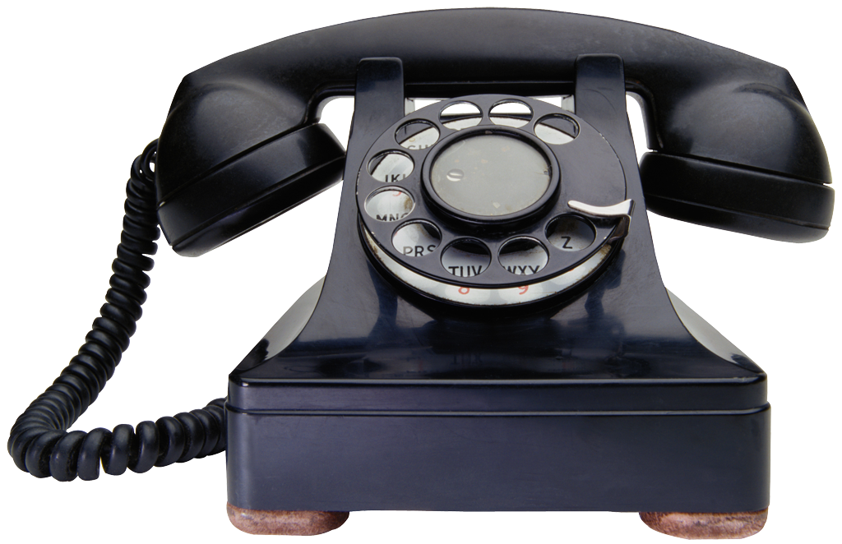
Step 3: Make some calls
I called 3 different agencies to find out what I could do to get recycling going (Lee County, Fort Myers, Waste Pro). I was met with no answer and I was told to call someone else. Eventually after hearing that 3 times, I was at a loss.

Slide 7
Step 4: My Lucky Day
On our field trip to the recycling center and the waste to energy plant, I finally got my answer!
They director at the recycling center answered my questions and also explained that he would contact coastal village himself.

Slide 8
Step 5: ACTION!
I called the recycling center to follow up and I got no response and I was discouraged. Then a week or so later I noticed a whole bunch of recycling bins right next to the dumpster!

Slide 9
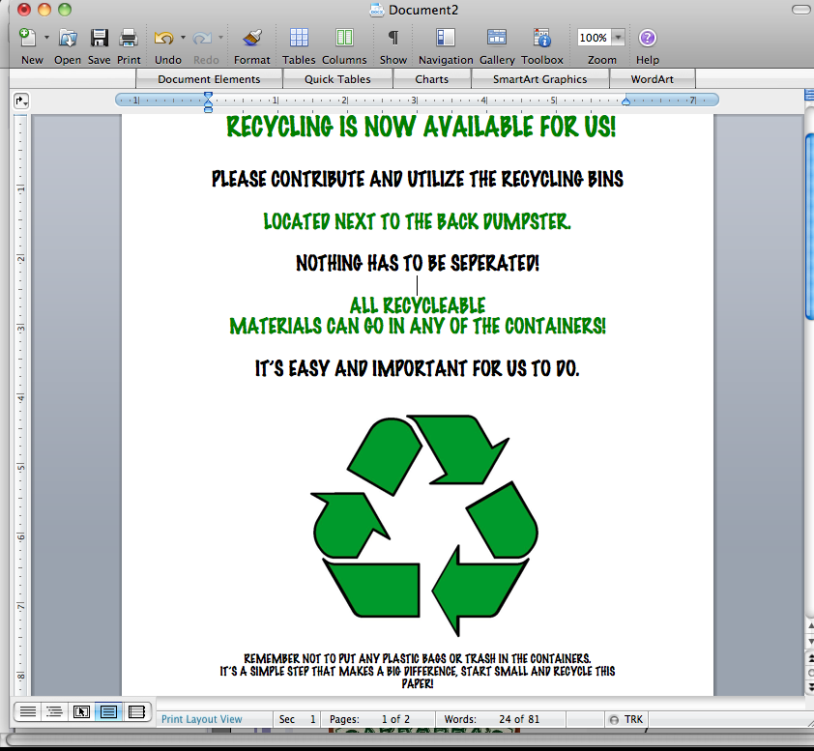
Step 6: Put it into action
I immediately began recycling, and noticed that some people began to recycle too!
I also made flyers and placed them around the complex.
It really happened!

Slide 10
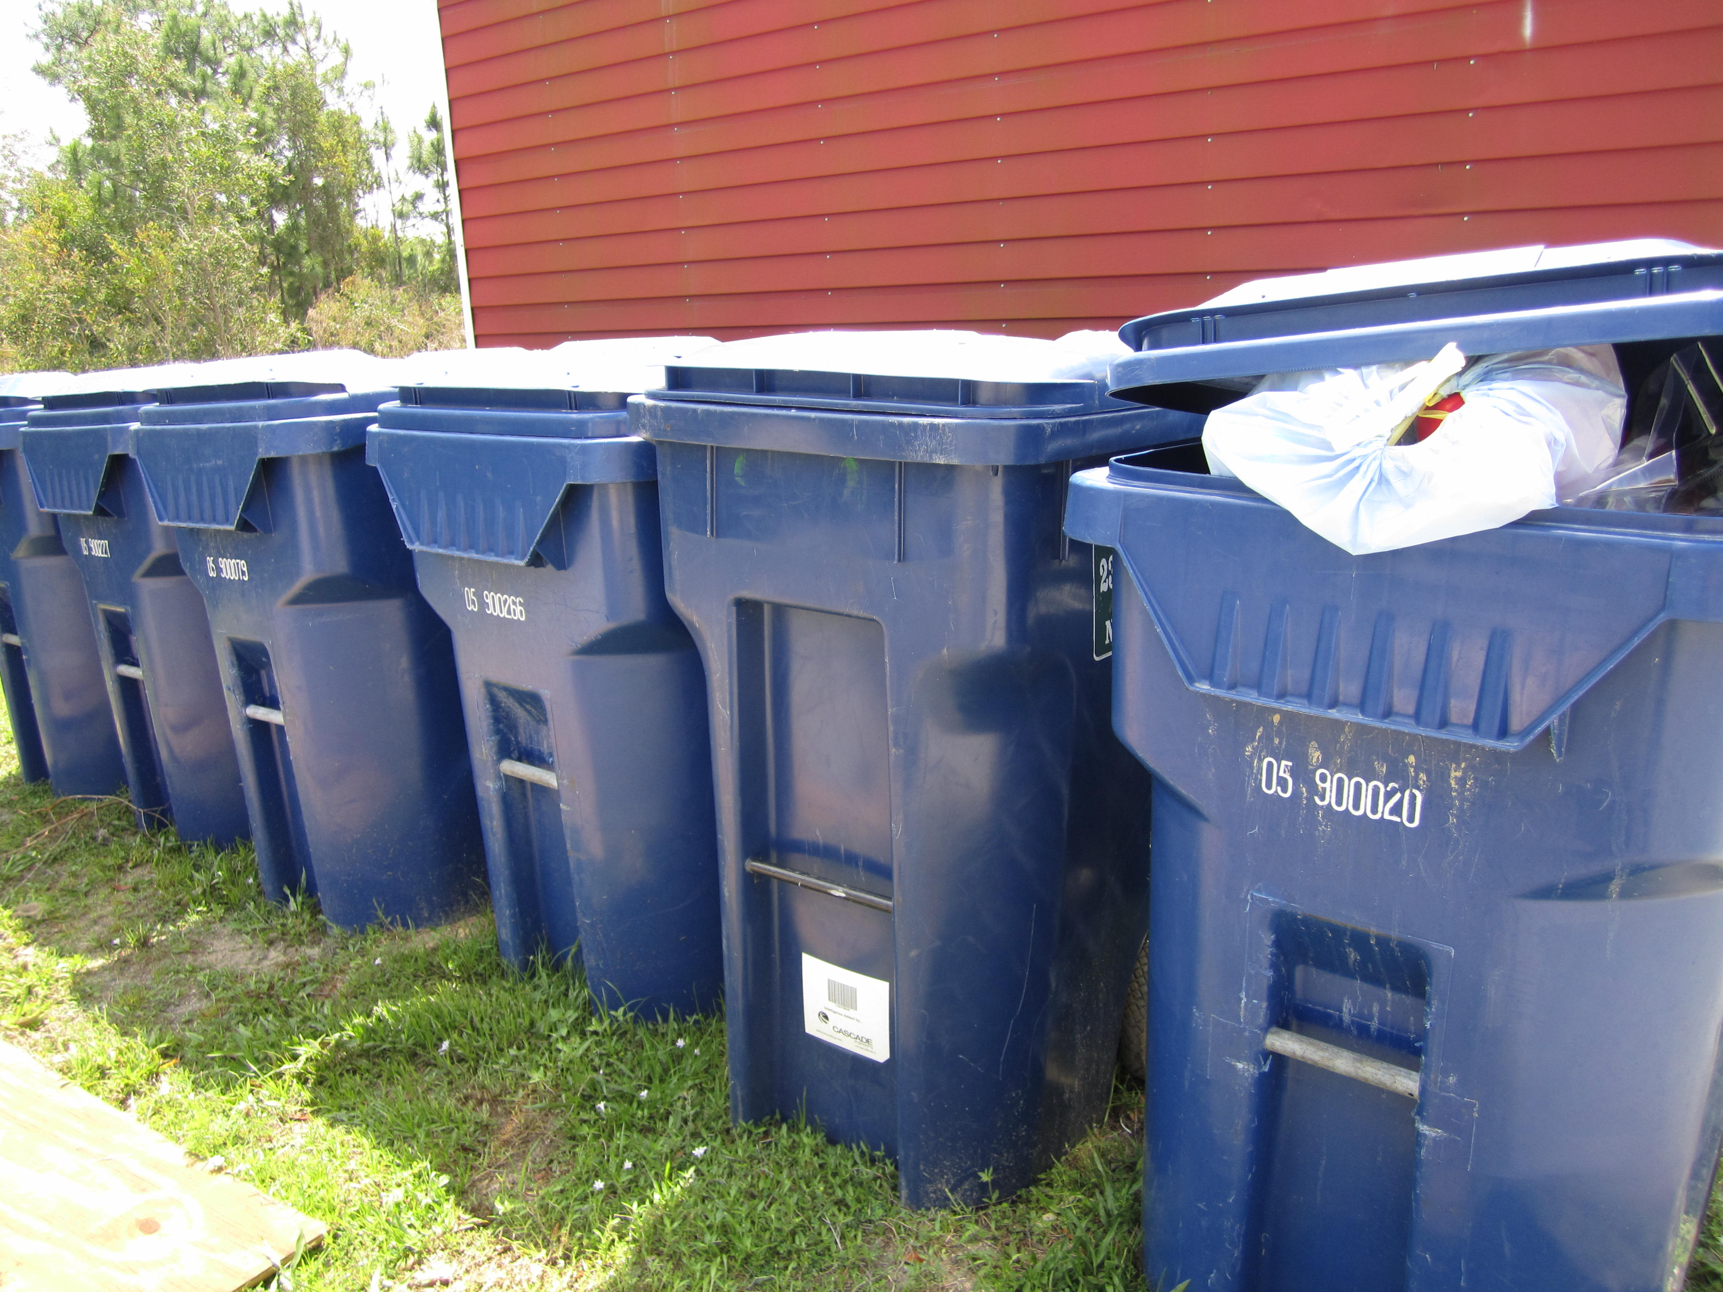
The Proof!

